Slide 1
INTRODUCTION TO ETHEREUM

Slide 2
WHAT IS ETHEREUM?
Ethereum is often referred to as "the world computer."
Ethereum can be described as a deterministic but practically unbounded state machine.
It consists of a globally accessible singleton state and a virtual machine that applies changes to that state.
Notes:
An unbounded state machine is a state machine that can run indefinitely without running out of memory or time. It is a state machine that can have an infinite number of states and transitions.
The "globally accessible singleton state" refers to Ethereum's blockchain, which is a shared, universal state of the system that every node in the network can access. This state contains all the account balances, smart contracts, and other data that make up Ethereum's decentralized network.

Slide 3
Question
Suppose you ask your friend to give you a random number. Result would be deterministic ? Why or why not?
Now Suppose you are executing a smart contract on Ethereum that generates a random number every time it runs. Given that every node executes this contract independently, would each node obtain the same result? Result would be deterministic ? Why or why not?

Slide 4
WHAT IS ETHEREUM?(Continued)
Ethereum is an open source, globally decentralized computing infrastructure.
It executes programs called smart contracts.
Smart contracts are executed on the Ethereum virtual machine(EVM).
It uses a blockchain to synchronize and store system's state changes.
Ethereum has its own cryptocurrency called Ether, which is used to meter and constrain execution resource costs.
Notes:
All state changes in Ethereum, including ether transfers, occur via the EVM. The EVM is a critical component of Ethereum's decentralized nature and security model, as it ensures that all nodes on the network agree on the state of the blockchain.

Slide 5
ETHEREUM'S FEATURES AND BENEFITS
Ethereum allows developers to build decentralized applications(Dapps) with built-in economic functions.
It offers high availability, auditability, transparency, and neutrality.
Ethereum reduces or eliminates censorship, enabling greater freedom of expression.
It also reduces certain counterparty risks associated with traditional centralized systems.

Slide 6
SIMILARITIES TO BITCOIN
Peer-to-peer network
Byzantine fault-tolerant consensus algorithm
Use of cryptographic primitives
Digital currency (ether)

Slide 7
Byzantine fault-tolerant (consensus algorithm)
BFT is a consensus algorithm that allows a network of nodes to agree on a single version of truth, despite a number of nodes being potentially faulty or malicious.
BFT operates in a system with 3f+1 total nodes, where f is the number of tolerable Byzantine (faulty or malicious) nodes.
The protocol works in a sequence of rounds, and in each round, one of the nodes is the designated "leader" who proposes the value for consensus.
The protocol consists of multiple phases, including the Pre-Prepare, Prepare, and Commit phases.
Each node requires 2f+1 acknowledgments including itself before change it’s phase

Slide 8
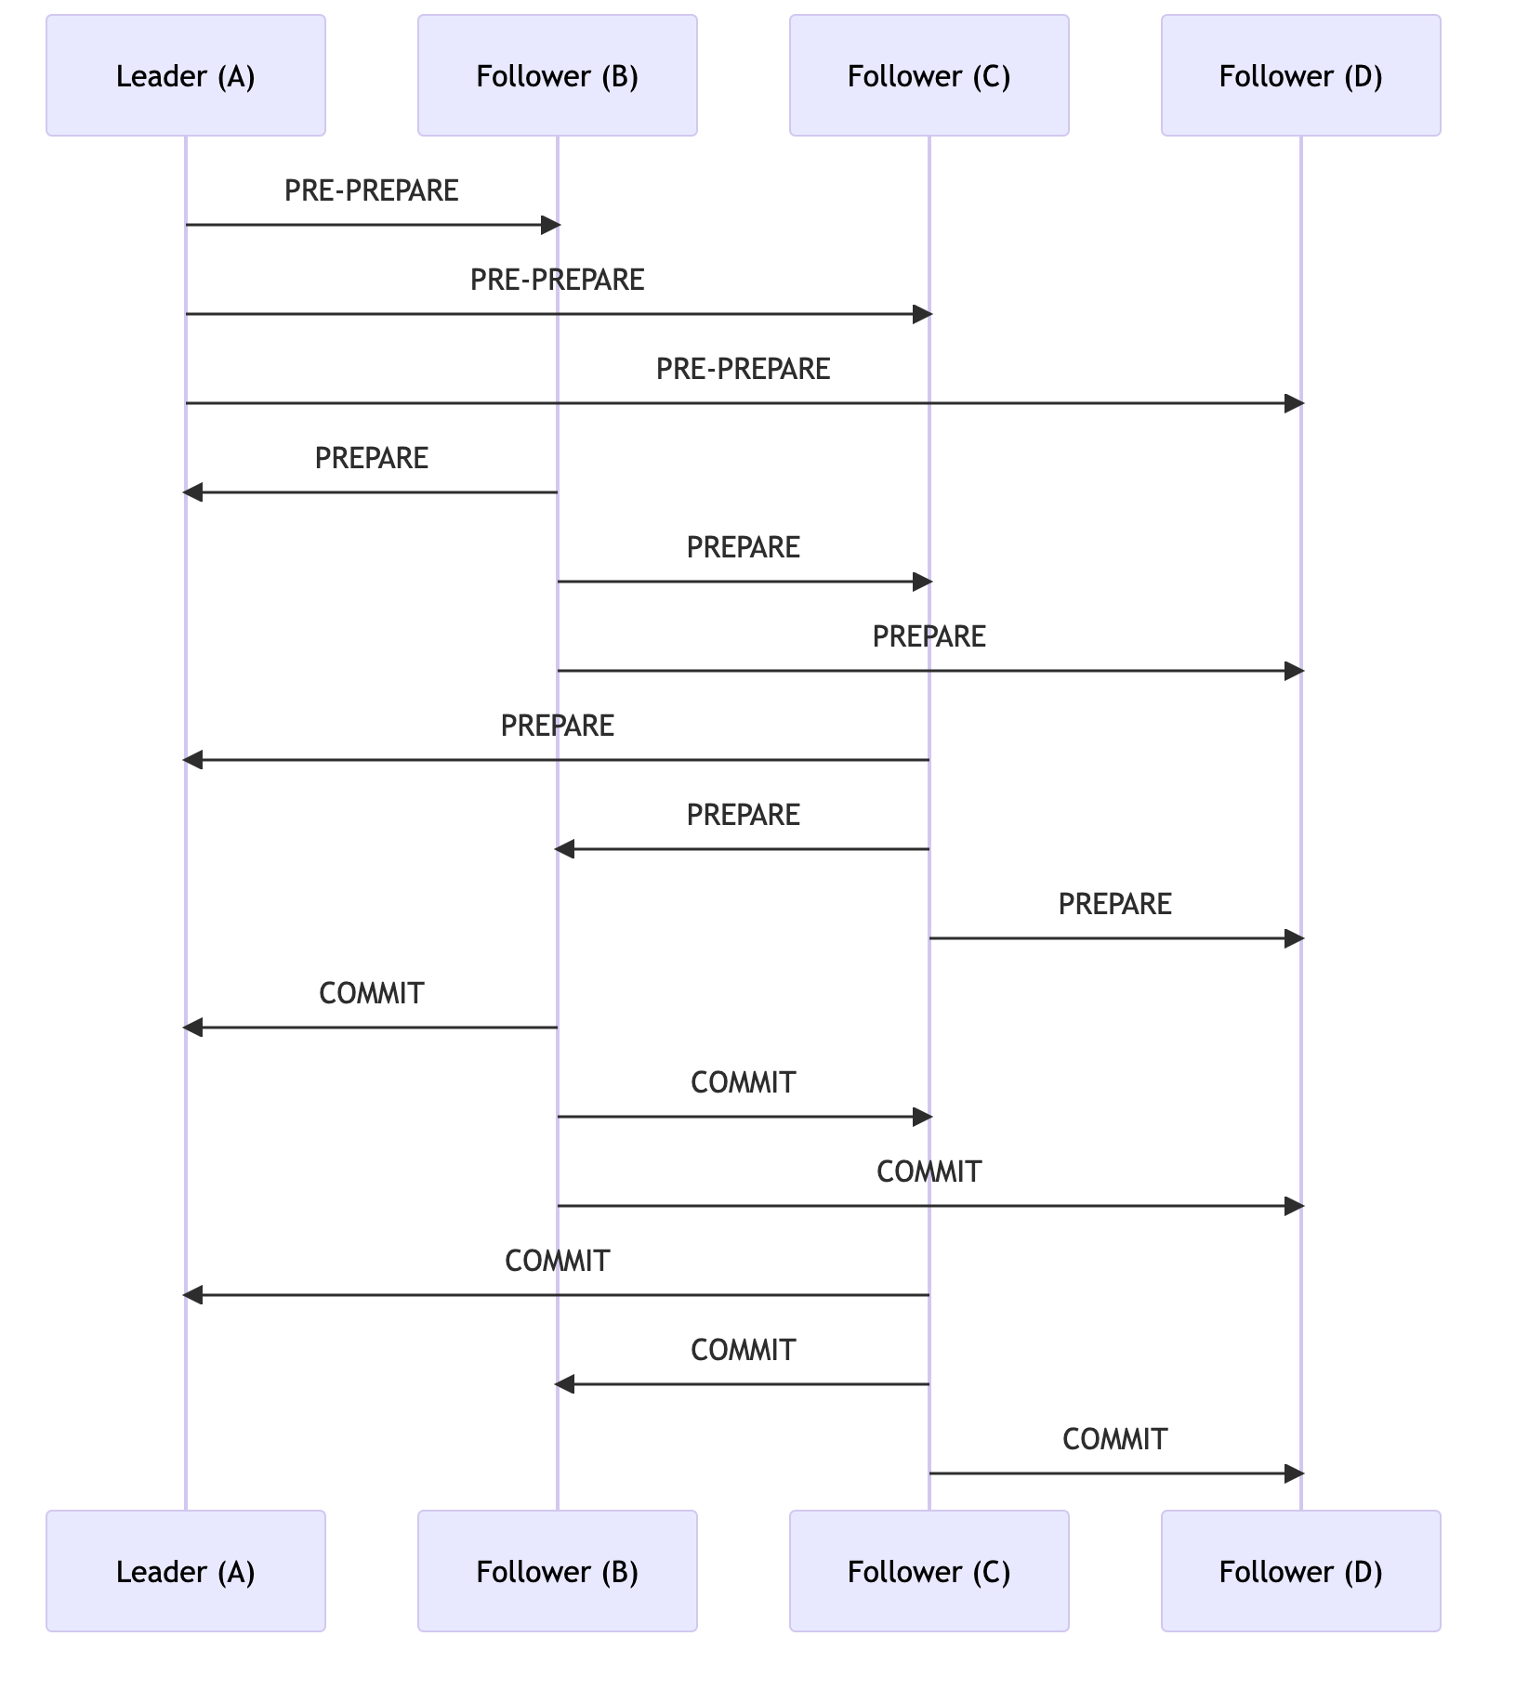
Notes:
let's look at a simplified example of Byzantine Fault Tolerance (BFT) using a consensus algorithm named Practical Byzantine Fault Tolerance (PBFT). PBFT is often used as an example because it was one of the first solutions providing high-performance Byzantine state machine replication, processing thousands of requests per second with sub-millisecond increases in latency.
Consider a network of 4 nodes (named A, B, C, D) that are trying to reach consensus on a specific value. In this scenario, we can tolerate 1 (i.e., (4-1)/3) Byzantine node, meaning a node that can fail arbitrarily or behave maliciously.
Let's assume node A is the leader node, proposing a value for consensus and nodes B, C, D are the follower nodes.
Node A sends a PRE-PREPARE message to all other nodes (B, C, D) proposing a value for consensus.
If the other nodes (B, C, D) agree with the proposed value, they enter the "prepared" phase by sending a PREPARE message to all other nodes.
Upon receiving at least two PREPARE messages from different nodes (including itself), a node enters the "committed" phase by broadcasting a COMMIT message to all other nodes.
A node finally "commits" the value when it has received at least two COMMIT messages from different nodes (including itself).
This way, even if one node behaves arbitrarily or maliciously, the system can still reach a consensus because committing a value requires at least three nodes (out of four) to agree.
For instance, if node D is a Byzantine node and does not agree with the leader's proposal, it won't matter because nodes B and C will send their PREPARE and COMMIT messages, helping the network reach consensus.
This is a simplified example. In a real-world scenario, there would also be mechanisms for changing the leader node if it's found to be faulty and other security considerations.

Slide 9
DIFFERENCES
Purpose: Not primarily a digital currency payment network.
Utility currency: Ether used to pay for Ethereum platform usage such as smart contract execution.
General-purpose programmable blockchain: Ethereum runs a virtual machine capable of executing complex code.
Turing complete: Ethereum's language allows arbitrary and unbounded complexity.
Notes:
Arbitrary: variable Unbonded: unlimited

Slide 10
ETHEREUM AND TURING COMPLETENESS
Ethereum is Turing complete, meaning it can simulate any Turing machine.
Turing completeness enables Ethereum to execute stored programs using the Ethereum Virtual Machine (EVM).
Ethereum's Turing completeness brings security and resource management challenges.

Slide 11
IMPLICATIONS OF TURING COMPLETENESS
Turing-complete systems can run infinite loops, posing challenges for predicting program termination
Ethereum introduces a metering mechanism called gas to constrain resource usage

Slide 12
BLOCKCHAIN LAYERS
Idea derived from OSI model
Each Layer has its own functionality.
Layers are used to make blockchain modular
Easy to modify.
Easy to upgrade.
Notes:
Explain what do you mean by modularity ?
Example of modular blockchains? OSI (Open Systems Interconnection) model Physical Layer (Layer 1):
Data Link Layer (Layer 2):
Network Layer (Layer 3):
Transport Layer (Layer 4):
Session Layer (Layer 5):
Presentation Layer (Layer 6):
Application Layer (Layer 7):

Slide 13
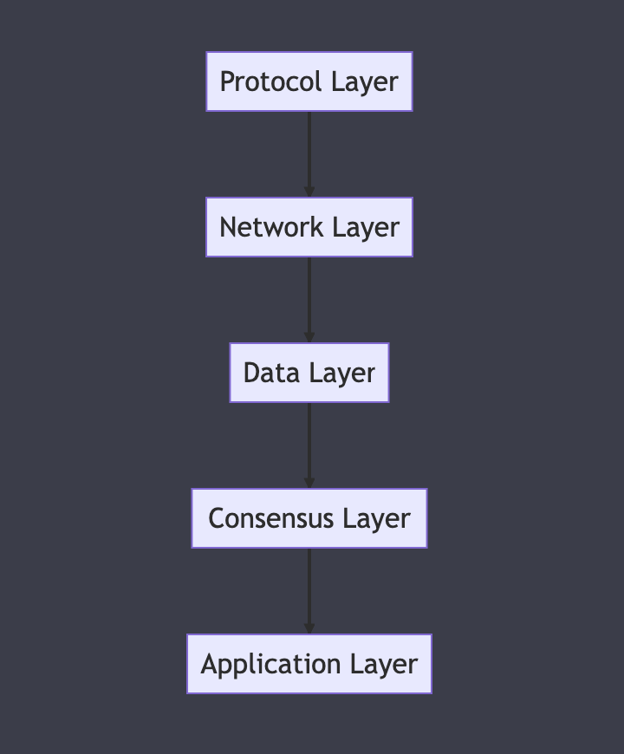
BLOCKCHAIN LAYERS
Notes:
Explain each layer with example OSI (Open Systems Interconnection) model Physical Layer (Layer 1): This layer involves the physical equipment involved in a data transmission, such as Ethernet cables, Wi-Fi signals, etc. In the case of Ethereum, this could be any physical hardware that an Ethereum node is running on, as well as the physical infrastructure of the internet that connects Ethereum nodes.
Data Link Layer (Layer 2): This layer establishes a local network communication path between two physically connected devices. It's responsible for node-to-node frame transportation on the same network. Ethereum does not directly deal with this layer, it is abstracted by the system's network hardware and drivers.
Network Layer (Layer 3): This layer manages packet forwarding including routing through different nodes in the network. Ethereum operates on top of this layer, with the Internet Protocol (IP) enabling communication between nodes across the internet.
Transport Layer (Layer 4): This layer provides transparent transfer of data between endpoints and is responsible for end-to-end error recovery and flow control. Ethereum uses TCP (Transmission Control Protocol) for reliable, ordered delivery of data streams.
Session Layer (Layer 5): This layer establishes, manages, and terminates connections between applications. Ethereum creates "sessions" between nodes in the network via TCP connections and the peer-to-peer protocol.
Presentation Layer (Layer 6): This layer transforms data to provide a standardized interface for the application layer. Ethereum's data structures, such as transactions and blocks, could be considered to be presented at this layer.
Application Layer (Layer 7): This is where application protocols exist, and it interacts with software applications that implement a communicating component. The Ethereum protocol itself (including the Ethereum Wire Protocol - DEVp2p, JSON-RPC interface, etc.) operates at this level. This is where nodes communicate with each other to propagate blocks and transactions, execute smart contracts, etc.

Slide 14
BLOCKCHAIN LAYERS
Protocol Layer:
Defines rules and standards of the blockchain and standards to communicate with external sources.
Like hardware
Network Layer:
Facilitates communication between nodes
Enables data transmission and synchronization
Maintains network decentralization and resilience
Uses Ethereum Wire protocol.
Notes:
The Ethereum Wire Protocol, often referred to as DEVp2p or simply the Ethereum protocol, is the network protocol used by Ethereum nodes to communicate with each other. It's the way they share blockchain data, transaction data, and other information. Here's a high-level summary:
Peer Discovery: Ethereum nodes need to find and connect with each other in order to form the peer-to-peer network. The protocol for this is the Node Discovery Protocol, which uses a Kademlia-like protocol to enable node discovery. Nodes keep a list of other nodes they've heard of and share this list with other nodes as needed.
Peer-to-Peer Communications: After discovering each other, nodes connect and communicate over a TCP connection, using the Ethereum Wire Protocol to structure this communication.
Message Types: There are several types of messages that nodes might send each other in order to synchronize their view of the Ethereum network. These include Status (exchange information about network IDs, head blocks, etc.), GetBlockHeaders (request block headers from a peer), BlockHeaders (send block headers to a peer), GetBlockBodies (request the bodies of specific blocks), BlockBodies (send the requested block bodies), NewBlock (announce a new block), and several others.
Data Synchronization: Ethereum Wire Protocol is also responsible for data synchronization. This includes blockchain synchronization, where nodes share block data in order to ensure they each have an accurate and up-to-date copy of the blockchain. It also includes transaction pool synchronization, where nodes share information about new transactions that haven't yet been included in a block.
Block Propagation: When a new block is mined, it needs to be quickly and efficiently propagated throughout the network so each node can add it to their copy of the blockchain. The Ethereum Wire Protocol defines the messages and rules for how this block propagation happens.
In summary, the Ethereum Wire Protocol is a critical part of the Ethereum ecosystem, defining how Ethereum nodes communicate, share data, and stay synchronized with each other. Without it, the Ethereum network as we know it wouldn't be possible.

Slide 15
BLOCKCHAIN LAYERS
Data Layer:
Stores and organizes data within the blockchain
Utilizes distributed databases or ledgers
Ensures data integrity and accessibility
Consensus Layer:
Achieves agreement on transaction validity and order
Implements consensus algorithms (e.g., PoW, PoS)
Secures the network and validates transactions

Slide 16
BLOCKCHAIN LAYERS
Application Layer:
Development and deployment of DApps
Incorporates smart contracts
Enables user interaction through UIs and APIs

Slide 17
Match Layers with Keywords
Protocol Layer
Network Layer
Data Layer
Consensus Layer
Application Layer
Byzantine fault-tolerant
Merkle Patricia Tree
EVM
Ethereum Wire Protocol
Hardware

Slide 18
Match Layers with Keywords
Protocol Layer
Network Layer
Data Layer
Consensus Layer
Application Layer
Byzantine fault-tolerant
Merkle Patricia Tree
EVM
Ethereum Wire Protocol
Hardware
Notes:
The Ethereum Wire Protocol, often referred to as DEVp2p or simply the Ethereum protocol, is the network protocol used by Ethereum nodes to communicate with each other. It's the way they share blockchain data, transaction data, and other information. Here's a high-level summary:
Peer Discovery: Ethereum nodes need to find and connect with each other in order to form the peer-to-peer network. The protocol for this is the Node Discovery Protocol, which uses a Kademlia-like protocol to enable node discovery. Nodes keep a list of other nodes they've heard of and share this list with other nodes as needed.
Peer-to-Peer Communications: After discovering each other, nodes connect and communicate over a TCP connection, using the Ethereum Wire Protocol to structure this communication.
Message Types: There are several types of messages that nodes might send each other in order to synchronize their view of the Ethereum network. These include Status (exchange information about network IDs, head blocks, etc.), GetBlockHeaders (request block headers from a peer), BlockHeaders (send block headers to a peer), GetBlockBodies (request the bodies of specific blocks), BlockBodies (send the requested block bodies), NewBlock (announce a new block), and several others.
Data Synchronization: Ethereum Wire Protocol is also responsible for data synchronization. This includes blockchain synchronization, where nodes share block data in order to ensure they each have an accurate and up-to-date copy of the blockchain. It also includes transaction pool synchronization, where nodes share information about new transactions that haven't yet been included in a block.
Block Propagation: When a new block is mined, it needs to be quickly and efficiently propagated throughout the network so each node can add it to their copy of the blockchain. The Ethereum Wire Protocol defines the messages and rules for how this block propagation happens.
In summary, the Ethereum Wire Protocol is a critical part of the Ethereum ecosystem, defining how Ethereum nodes communicate, share data, and stay synchronized with each other. Without it, the Ethereum network as we know it wouldn't be possible.

Slide 19
ETHEREUM’S FOUR STAGES OF DEVELOPMENT
Frontier - Initial stage (July 30, 2015, to March 2016)
Homestead - Second stage (launched in March 2016).It included several protocol improvements and was considered to be a more stable release that marked the exit from the beta stage to full functionality for developers and users
Metropolis Byzantium - First part of Metropolis (launched in October 2017). Introduced the idea of Proof-of-stake.
Serenity (Ethereum 2.0) - Final stage for scalability, security, and sustainability. Implemented POS.
Notes:
Fun fact about price of ethereum

Slide 20
DAO ATTACK AND ETHEREUM SPLIT
At block #1,192,000, Ethereum experienced the DAO attack
The DAO was a smart contract-based investment fund
A vulnerability in the DAO's code was exploited, resulting in a significant theft of Ether (ETH)
A hard fork was implemented to revert the blockchain and return the stolen funds
The hard fork caused a split in the Ethereum community
Ethereum Classic (ETC) emerged as a separate blockchain, maintaining the original transaction history
This event highlighted debates about governance and immutability in decentralized systems
Notes:
Explain DAO with board diagram
Explain Difference between soft-fork and hard-fork with board diagram
Explain the how hard fork implemented by ethereum.

Slide 21
Hard-fork and Soft-fork
Hard Fork
a hard fork splits a blockchain into two, with a change in the blockchain’s code meaning there are now two versions.
A hard fork creates two versions of the blockchain which are not compatible with each other. This means that nodes running on the new version of the blockchain will not recognize transactions being made on the old version, and vice-versa. All nodes on the blockchain must agree to the change for the hard fork to happen.
Soft Forks
It is a software upgrade that is backwards compatible with older versions of the blockchain.
This means that those miners who haven’t yet upgraded to the later version of the software are still able to participate in validating and verifying transactions.

Slide 22
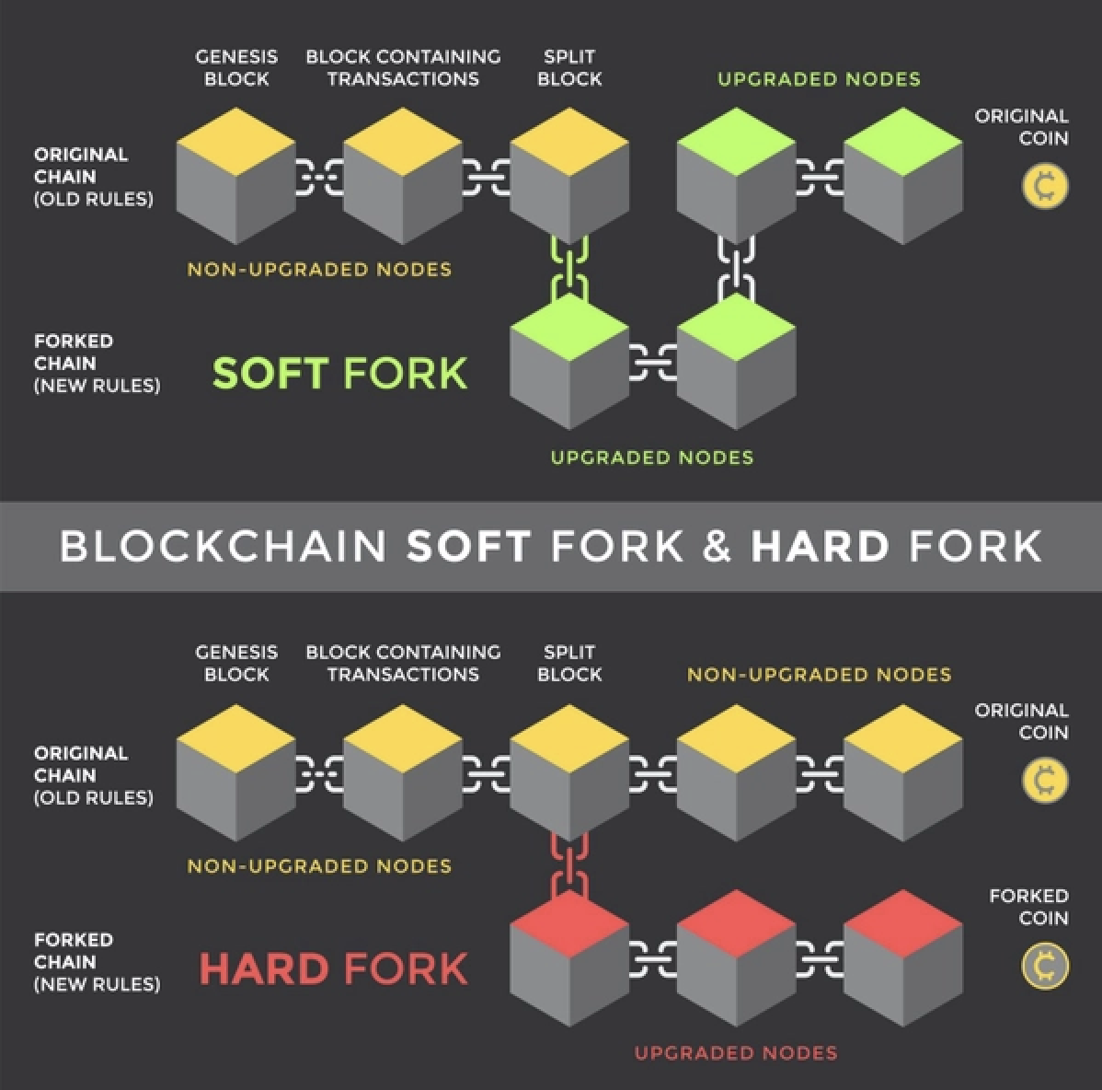
Hard-fork and Soft-fork

Slide 23
THE THIRD AGE OF THE INTERNET: WEB3 AND ETHEREUM
Web 2.0 brought user-generated content and interactivity to the web
DApps represent the next stage, introducing decentralization through Web3
Web3 is the vision for the third version of the web, built on decentralized protocols
Ethereum plays a pivotal role in Web3, enabling the development of decentralized applications
Notes:
What’s web 2.0? Example
What’s web 3.0? example
how web3.0 is used with web2.0(Back-end)

Slide 24
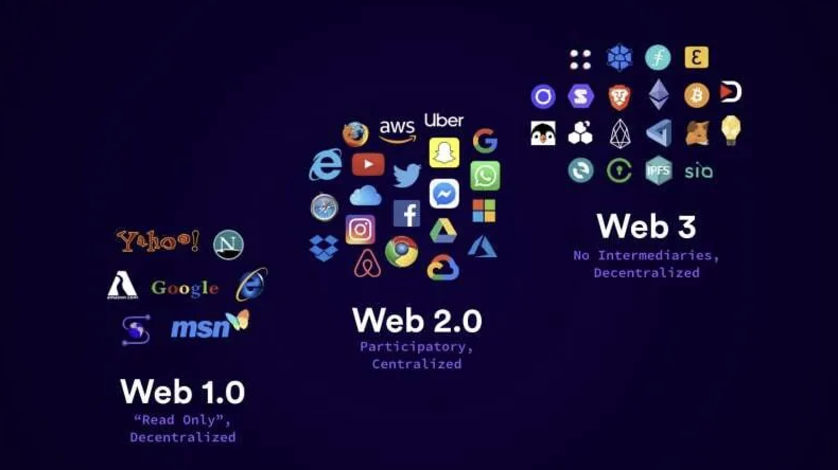
THE THIRD AGE OF THE INTERNET: WEB3 AND ETHEREUM
Notes:
web 1.0: static pages
web 2.0: centralized pages
web 3.0: decentralized

